Slide 1
Overfitting and its Avoidance

Slide 2
Overfitting ,Underfitting and Generalization
Generalization is a term used to describe a model’s ability to react to new data. That is, after being trained on a training set, a model can digest new data and make accurate predictions. A model’s ability to generalize is central to the success of a model. If a model has been trained too well on training data, it will be unable to generalize. It will make inaccurate predictions when given new data, making the model useless even though it is able to make accurate predictions for the training data. This is called overfitting. The inverse is also true. Underfitting happens when a model has not been trained enough on the data. In the case of underfitting, it makes the model just as useless and it is not capable of making accurate predictions, even with the training data.

Slide 3
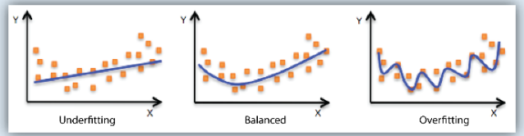
Under fitting, Balanced and Over fitting

Slide 4
Holdout
Rather than using all of our data for training, we can simply split our dataset into two sets: training and testing. A common split ratio is 80% for training and 20% for testing. We train our model until it performs well not only on the training set but also for the testing set. This indicates good generalization capability since the testing set represents unseen data that were not used for training. However, this approach would require a sufficiently large dataset to train on even after splitting.

Slide 5
Cross-validation (data)
We can split our dataset into k groups (k-fold cross-validation). We let one of the groups to be the testing set (please see hold-out explanation) and the others as the training set, and repeat this process until each individual group has been used as the testing set (e.g., k repeats). Unlike hold-out, cross-validation allows all data to be eventually used for training but is also more computationally expensive than hold-out.

Slide 6
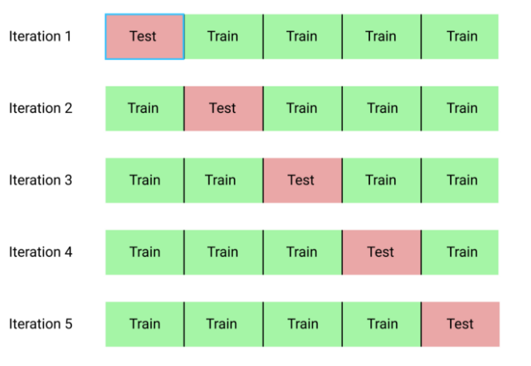
Cross Validation

Slide 7
Data augmentation (data)
A larger dataset would reduce overfitting. If we cannot gather more data and are constrained to the data we have in our current dataset, we can apply data augmentation to artificially increase the size of our dataset. For example, if we are training for an image classification task, we can perform various image transformations to our image dataset (e.g., flipping, rotating, rescaling, shifting).

Slide 8
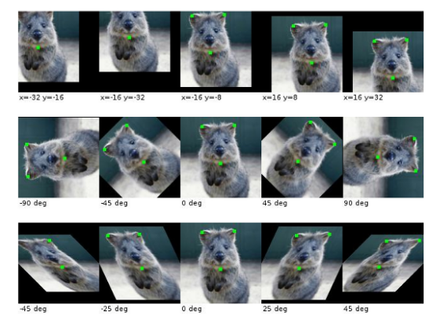

Slide 9
Feature selection (data)
If we have only a limited amount of training samples, each with a large number of features, we should only select the most important features for training so that our model doesn’t need to learn for so many features and eventually overfit. We can simply test out different features, train individual models for these features, and evaluate generalization capabilities, or use one of the various widely used feature selection methods.

Slide 10
Thank You

